Slide 1
Technology in the Workforce: Does it Enhance or Inhibit
Erica Slye

Slide 2
Why I chose this topic:
Crazy coworker story

Slide 3
(Using phone for notes)
(Before I start, I have some speaking notes that are on my phone. Just to let you know that I’m not messing around on it or anything. However, it is also to make a point about technology in the workplace; whether this is helping or inhibiting. Yes it may be helping me present concerning points that I make, but is it keeping my attention away from the audience? In the workforce, would a move like this keep me from making a successful presentation or is it typical for one to be constantly looking to their phone to the point where the professionalism of the situation isn’t hindered? Just some thoughts to ponder.)

Slide 4
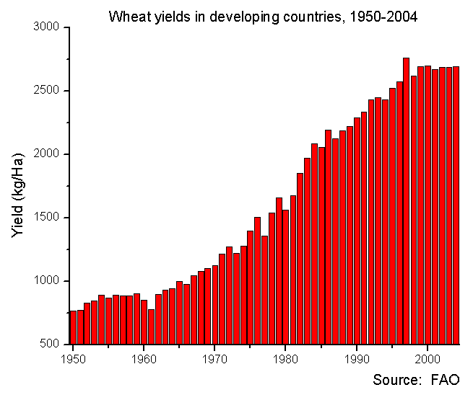
Pro 1:
Technology produces efficiency allowing for greater steps to be taken in the workplace (this is done not only by day to day operations, but allows for long term improvement through basic communication technology, software development, or simple security and protection to digital aspects of a firm)
“Technology is reshaping the workplace, and having the right tools in place will help you and your team stay ahead.” – Elizabeth Dukes (sales associate) (1)
Increased productivity = increased profit **
  Graph: as technology increases, so does efficiency,
  therefore increasing profit (7)

Slide 5
Pro 2:
(ok so now that we know that technology increases efficiency and productivity, how exactly does that promote or enhance the workforce, particularly concerning jobs? Welll…)
The increase in jobs made available due to technology offsets the decrease in jobs that technology replaces (2)

Slide 6
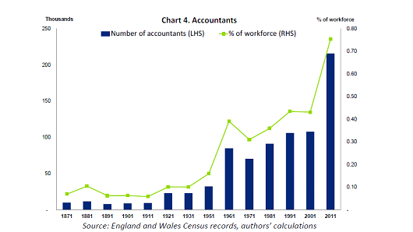
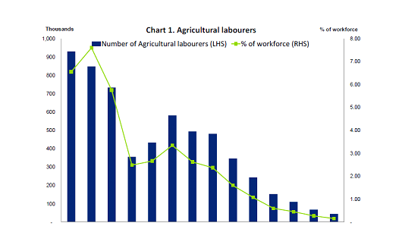
Pro 2 Cont:
(8)
(As you can see, not only the number of people doing agricultural labor are decreasing and accountants increasing, but the percentage of the workforce that not only work with technology but also manage finances and profit continues to increase)

Slide 7
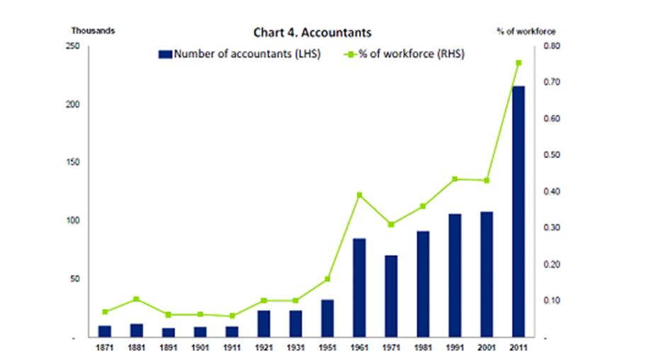
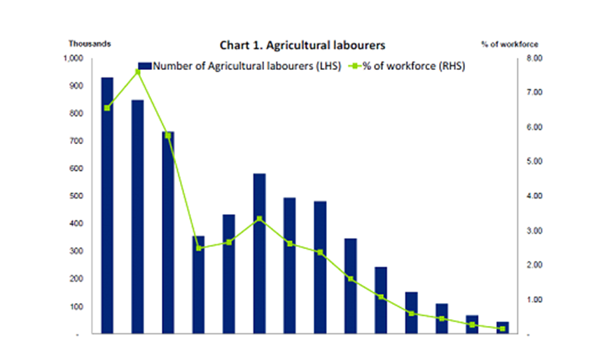
Con 1:
(8)
(The last part of the pro can be refuted by arguing that while jobs in technology have increased, they don’t fully compensate for the number of jobs that were replaced. Plus, he graphs are not to the same scale and this proves be misleading. Yes, some jobs are being relocated, yet all of them are not being compensated for, therefore invalidating the previous argument.)

Slide 8
Pro 3:
Technology increases human capital relating to things such as having the internet to spread info, background screenings, and advertising across the board (3)
Technology in the workplace improves the efficiency of screening, recruiting, and hiring potential candidates. (7)
Businesses utilize the Internet (to spread the word about the organization and advertise job openings. Hiring managers can target candidates by using digital advertising technology that tracks the websites they visit.) (7)
Personality assessments and screening tools (allow businesses to determine whether a potential candidate is an appropriate fit for the organization.) (7)
(So, this tells us that technology not only facilitates the hiring process, but allows for qualified individuals to be initially hired)

Slide 9
Con 2:
The use of 50,000 to 100,000 industrial robots can potentially result in a net loss of 100,000 jobs (6)
(That’s just a pretty straightforward statistic, so yeah)

Slide 10
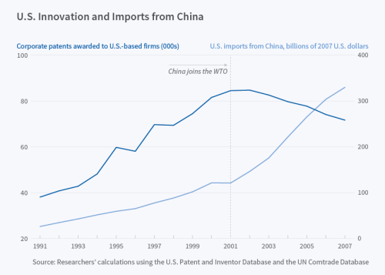
Con 3:
Technology is giving value and jobs to other countries rather than the United States by shifting their factories to lower-cost countries (5)
The US is importing more and more from
countries like China (therefore moving production
jobs to outside of the US)
(As the graph shows, since about 2001, the
number of patents awarded to US companies
have been declining while imports
from China have steadily increase.)
(7)

Slide 11
Pro/Con (?):
Increase in technology results in the creation of jobs that require training or a field of expertise
(So people who cannot afford an education might have difficulty getting a steady job because they do not have an education, therefore making it difficult for them to make money to get that education to get a job…and it’s all just an endless cycle)
(On the other hand, this reality has the potential to further motivate individuals to pursue an education and set goals, hopefully furthering the general US economy)

Slide 12
Citations:
Chitakasem. Technology In the Workplace: 5 Reasons To Keep Up. Web. https://www.ivyexec.com/executive-insights/2013/5-reasons-to-keep-up-with-technology-in-the-workplace/
Dukes. Ways that Technology has Changed the Modern Workplace. December 23, 2014. Web. https://www.iofficecorp.com/blog/4-ways-technology-has-changed-the-modern-workplace
Impacts of Technological Change in Productivity. Boundless. Web. https://www.boundless.com/economics/textbooks/boundless-economics-textbook/economic-growth-20/productivity-98/impacts-of-technological-change-on-productivity-370-12467/)
Makortoff, Kalyeena. Don’t fear the robots, tech creats jobs. August 19, 2015. CNBC. Web. http://www.cnbc.com/2015/08/19/dont-fear-the-robots-tech-creates-more-jobs-than-it-destroys-report.html
Manufacturing’s Productivity Myth. October 26, 2016. Web. http://economistsview.typepad.com/economistsview/technology/
Rotman. How Technology is Destroying Jobs. June 12, 2013. Web. https://www.technologyreview.com/s/515926/how-technology-is-destroying-jobs/
Scott. Importance of Technology in the Workplace. Web. http://smallbusiness.chron.com/importance-technology-workplace-10607.html
Sharplin. Marby. Does more Technology Create Unemployment?. March 18, 1986. Web. https://www.libertarianism.org/publications/essays/does-more-technology-create-unemployment

